Slide 1
Database System
Lecture 9

Slide 2
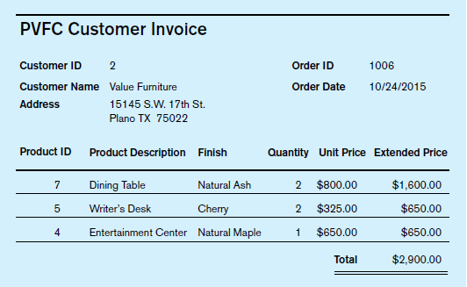
Normalization Example: Pine Valley Furniture Company
For a simple illustration, we use a customer invoice from Pine Valley Furniture Company

Slide 3
Step 0: Represent the View in Tabular Form
The first step (preliminary to normalization) is to represent the user view (in this case, an invoice) as a single table, or relation, with the attributes recorded as column headings.
Sample data should be recorded in the rows of the table, including any repeating groups that are present in the data.
New data for a second order (OrderID 1007) are included in table to clarify further the structure of this data.

Slide 4
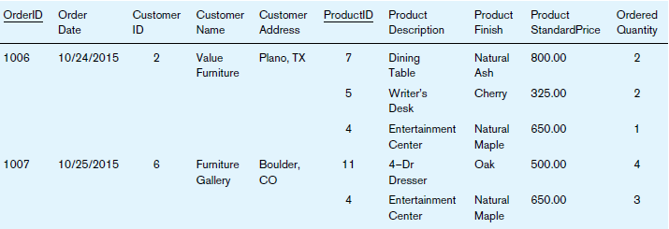

Slide 5

Step 1: Convert to First Normal Form
A relation is in first normal form (1NF) if the following two constraints both apply:
There are no repeating groups in the relation (thus, there is a single fact at the intersection of each row and column of the table).
A primary key has been defined, which uniquely identifies each row in the relation.
Remove Repeating Groups: The invoice data in invoice table contain a repeating group for each product that appears on a particular order. Thus, OrderID 1006 contains three repeating groups, corresponding to the three products on that order.
Select the Primary Key: There are four determinants in INVOICE, and their functional dependencies are the following:

Slide 6
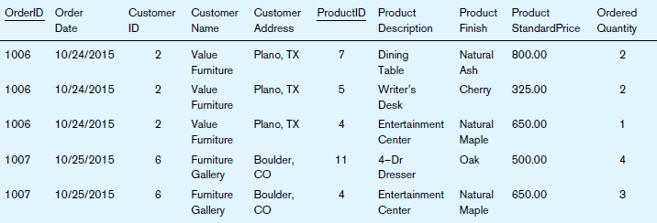
Step 1: Convert to First Normal Form INVOICE relation (1NF)

Slide 7
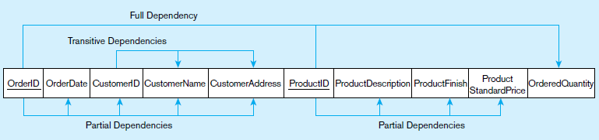
Step 1: Convert to First Normal Form Functional dependency diagram for INVOICE
A diagram that shows these functional dependencies for the INVOICE relation is shown in below figure. This diagram is a horizontal list of all the attributes in INVOICE, with the primary key attributes (OrderID and ProductID) underlined. Notice that the only attribute that depends on the full key is OrderedQuantity. All of the other functional dependencies are either partial dependencies or transitive dependencies (both are defined next).

Slide 8
Step 1: Convert to First Normal Form Anomalies in 1NF
Insertion anomaly: With this table structure, the company is not able to introduce a new product (say, Breakfast Table with ProductID 8) and add it to the database before it is ordered the first time: No entries can be added to the table without both ProductID and OrderID.
Deletion anomaly: If a customer calls and requests that the Dining Table be deleted from her OrderID 1006, this row must be deleted from the relation, and we lose the information concerning this item’s finish (Natural Ash) and price ($800.00).
Update anomaly: If Pine Valley Furniture (as part of a price adjustment) increases the price of the Entertainment Center (ProductID 4) to $750.00, this change must be

Slide 9
Step 2: Convert to Second Normal Form
To convert a relation with partial dependencies to second normal form, the following steps are required:
Create a new relation for each primary key attribute (or combination of attributes) that is a determinant in a partial dependency. That attribute is the primary key in the new relation.
Move the nonkey attributes that are only dependent on this primary key attribute (or attributes) from the old relation to the new relation.
Removal of the partial dependencies results in the formation of two new relations: PRODUCT and CUSTOMER ORDER. The INVOICE relation is now left with just the primary key attributes (OrderID and ProductID) and OrderedQuantity, which is functionally dependent on the whole key. We rename this relation ORDER LINE, because each row in this table represents one line item on an order.

Slide 10
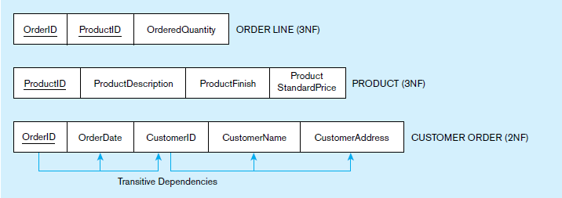
Step 2: Convert to Second Normal Form
The relations ORDER LINE and PRODUCT are in third normal form. However, CUSTOMER ORDER contains transitive dependencies and therefore (although in second normal form) is not yet in third normal form.

Slide 11
Step 2: Convert to Second Normal Form
A relation that is in first normal form will be in second normal form if any one of the following conditions applies:
The primary key consists of only one attribute (e.g., the attribute ProductID in the PRODUCT relation in Figure 4-28). By definition, there cannot be a partial dependency in such a relation.
No nonkey attributes exist in the relation (thus all of the attributes in the relation are components of the primary key). There are no functional dependencies in such a relation.
Every nonkey attribute is functionally dependent on the full set of primary key attributes (e.g., the attribute OrderedQuantity in the ORDER LINE relation).

Slide 12

Step 3: Convert to Third Normal Form
A relation is in third normal form (3NF) if it is in second normal form and no transitive dependencies exist.
A transitive dependency in a relation is a functional dependency between the primary key and one or more nonkey attributes that are dependent on the primary key via another nonkey attribute.
For example, there are two transitive dependencies in the CUSTOMER ORDER relation
Transitive dependencies create unnecessary redundancy that may lead to the typeof anomalies

Slide 13
Step 3: Convert to Third Normal Form
You can easily remove transitive dependencies from a relation by means of a three-step procedure:
For each nonkey attribute (or set of attributes) that is a determinant in a relation, create a new relation. That attribute (or set of attributes) becomes the primary key of the new relation.
Move all of the attributes that are functionally dependent only on the primary key of the new relation from the old to the new relation.
Leave the attribute that serves as a primary key in the new relation in the old relation to serve as a foreign key that allows you to associate the two relations.

Slide 14
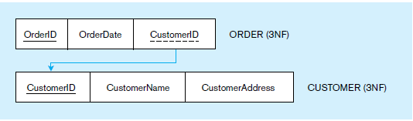
Step 3: Convert to Third Normal Form
A new relation named CUSTOMER has been created to receive the components of the transitive dependency. The determinant CustomerID becomes the primary key of this relation, and the attributes CustomerName and CustomerAddress are moved to the relation. CUSTOMER ORDER is renamed ORDER, and the attribute CustomerID remains as a foreign key in that relation.

